Slide 1

Delivery Logistics
Final project prepared by:
Oleksandr Bachynsky, 83457
Oleksandr Romanchenko, 83459
Nazarii Melnyk, 83471
Field of Study:
Advanced Analytics-Big Data
Subject:
Advanced Simulation Modelling
Warsaw, 2020

Slide 2
Agenda
1. Introduction
2. Travelling salesman problem (TSP)
3. The vehicle routing problem (VRP)
a) Basic Goal of the VRP
b) VRP constraints
4. Key Findings
5. Sensitivity analysis
6. Conclusions

Slide 3
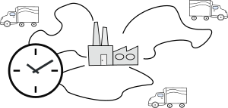
Introduction
The problem described in this presentation is a VHR (Vehicle Routing Problem), the main goal of which is to minimize the number of vehicles needed to serve all customers or minimize the global transportation cost based on the global distance travelled as well as the fixed costs associated with the used vehicles and drivers.
Notes:
Due to their huge importance in practice, these problems have called the attention of many researchers and motivated a large number of collaborations between companies and academia. In addition, vehicle routing problems lead to challenging formulations that require the development of sophisticate solution strategies and motivates the design of clever heuristics and meta-heuristics.

Slide 4
Travelling salesman problem (TSP)
The travelling salesman problem (TSP) is a classical dilemma used for testing the effectiveness of various optimization algorithms.
The problem is stated as:
"Given a list of cities and the distances between each pair of cities, what is the shortest possible route that visits each city and returns to the origin city?”

Slide 5
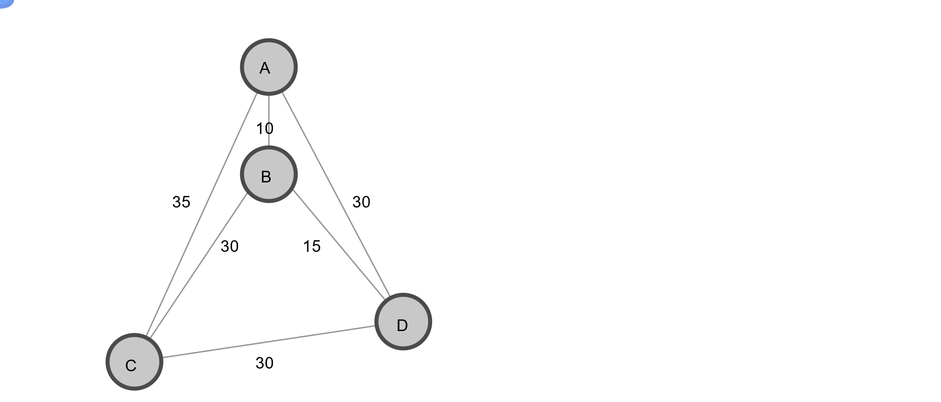
Graph example for TSP
A TSP can be represented by a graph, in which the nodes correspond to the locations, and the edges (or arcs) denote direct travel between locations. For example, the graph below shows a TSP with just four locations, labelled A, B, C, and D. The distance between any two locations is given by the number next to the edge joining them. By calculating the distances of all possible routes, you can see that the shortest route is ACDBA, for which the total distance is 35 + 30 + 15 + 10 = 90.

Slide 6
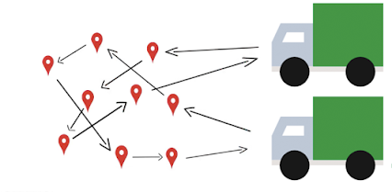
The vehicle routing problem (VRP)
A more general and complex version of the TSP is the vehicle routing problem (VRP), in which there are multiple vehicles. In most cases, VRPs have constraints: for example, vehicles might have capacities for the maximum weight or volume of items they can carry, or drivers might be required to visit locations during specified time windows requested by customers.

Slide 7
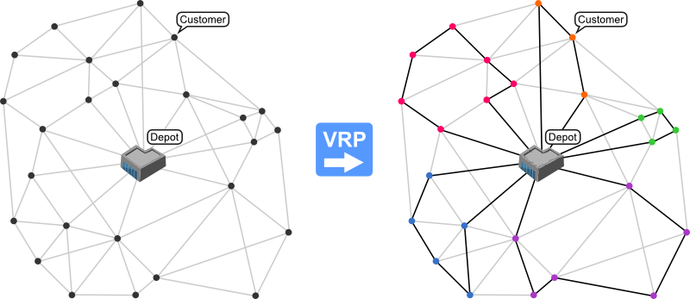
The objective function of a VRP can be very different depending on the particular application of the result but a few of the more common objectives are:
Minimize the global transportation cost based on the global distance travelled as well as the fixed costs associated with the used vehicles and drivers
Minimize the number of vehicles needed to serve all customers
Least variation in travel time and vehicle load
Minimize penalties for low quality service

Slide 8
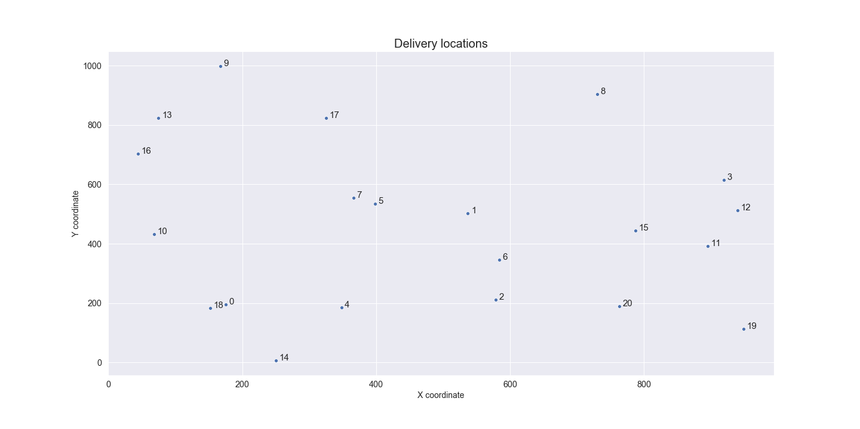
Basic Goal of the VRP
In general, the optimal solution for a VRP problem is defined as a solution for all elements simultaneously, not each element separately. Typically, the goal is to minimize the length of the longest single route among all vehicles.
Step I. To determine the number of delivery locations, as well as their coordinates
Notes:
The figure shows the city grid with marked locations. The Depot is marked as 0 and is located in the southwest part of the city. As can be seen from the figure, the location coordinates are generated randomly - we have locations with close proximity as well as locations that are on the other side of the town.

Slide 9
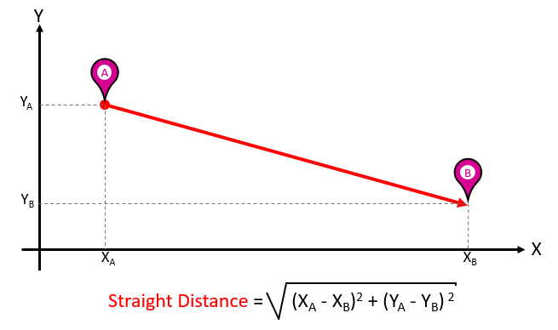
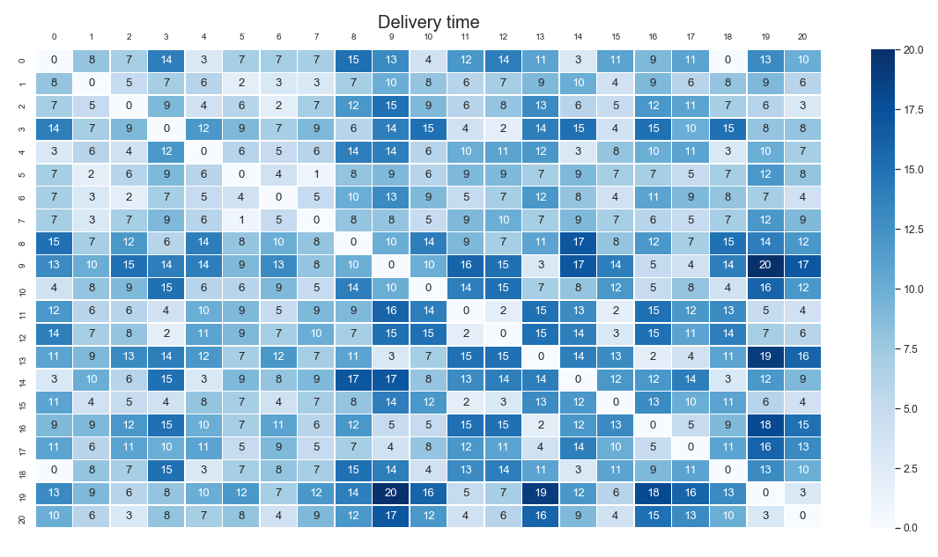
Step II. To determine the minimum time needed to reach each location
The minimum time needed to reach each location:
Notes:
1) Step II : The next step is to determine the minimum time needed to reach each location. We are assuming that each location is connected via a straight line. In order to calculate the distance, we are using the Euclidian distance which is shown in the figure.
2) Assuming that each car travels with the speed of 60 km/h, we can calculate the minimum time needed to reach each location. The heatmap shows these time requirements. In general, a delivery between nearby locations requires a couple of minutes, while for distant locations the delivery can last up to 20 minutes (for example, between locations 9 and 19).

Slide 10
VRP constraints
Capacity constraints - The capacitated vehicle routing problem (CVRP) is a VRP in which vehicles with limited carrying capacity need to pick up or deliver items at various locations. The items have a quantity, such as weight or volume, and the vehicles have a maximum capacity that they can carry. The problem is to pick up or deliver the items for the least cost, while never exceeding the capacity of the vehicles.
Time constraints - Many vehicle routing problems involve scheduling visits to customers who are only available during specific time windows. These problems are known as vehicle routing problems with time windows (VRPTWs). Similarly, to the delivery volumes, the locations are defining certain time windows during which they can accept a delivery. This way the company has to plan a route that will allow the car to reach the location at a specified time.
Penalties and Dropping Visits - Given all constraints described above, there could be no feasible solution present. For example, if you are given a VRP with capacity constraints in which the total demand at all locations exceeds the total capacity of the vehicles, no solution is possible. In order to address such issue, we will allow the vehicles to drop visits to some locations. The problem is how to decide which visits to drop.

Slide 11
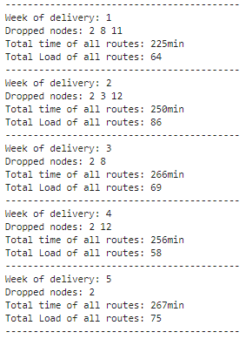
Key Findings
After running the algorithm, we obtain information regarding the total time needed to deliver the goods, the total load of the delivery and the locations excluded due to certain issues – either the order was too big, the time window was not suitable or there was some accident on the road leading to that location.
After analysing the excluded nodes, we can conclude that out of 21 exclusion cases, 14 (66%) were at location 2. This means that there is an issue with reaching that location and the advice to the company would be to reconsider the feasibility of servicing it.

Slide 12
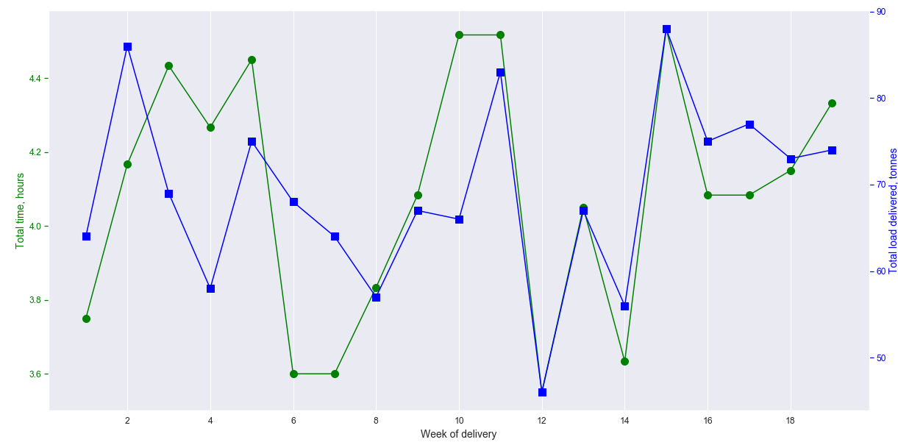
The plot above shows the total time and total delivered load for each of the weeks. We can see serious fluctuations in time (from 3.6 to 4.5 hours) and delivery volumes (from 46 to 88 tonnes). The time differences can be explained by two things – available time windows and accidents on the road. They both affect the total delivery time. As for the delivery volumes, they are affected by the placed order, car capacity and feasibility of a delivery to a certain location.

Slide 13
Sensitivity analysis
There are several parameters that can be changed for our model:
Number of locations
Number of cars and their capacity
Load/unload times
Depot capacity
We will focus on the car capacity, load/unload times, depot capacity, number of cars parameter on our sensitivity analysis

Slide 14
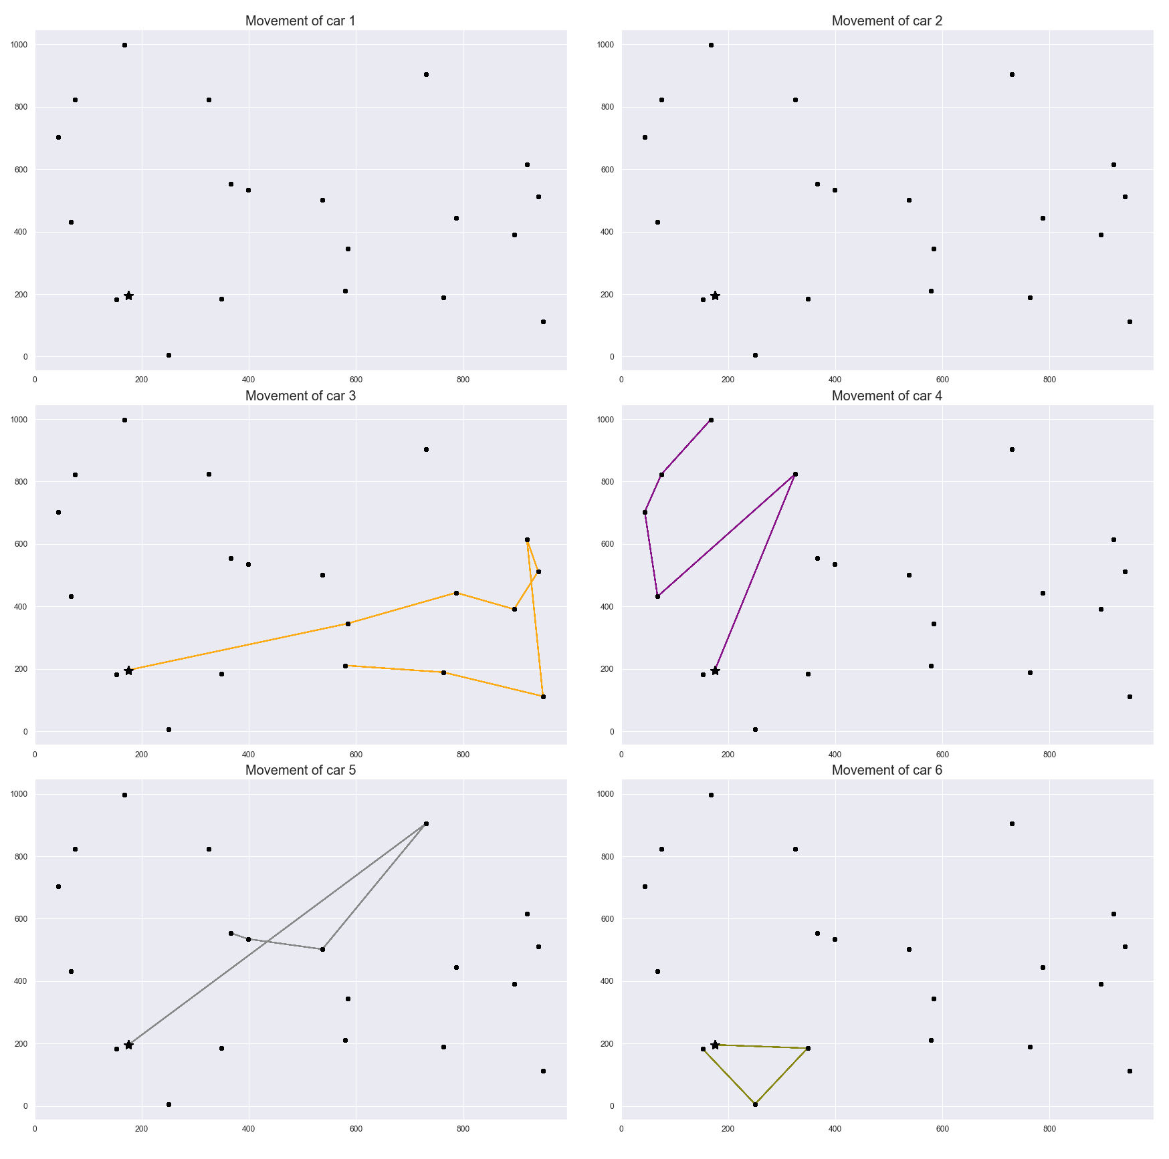
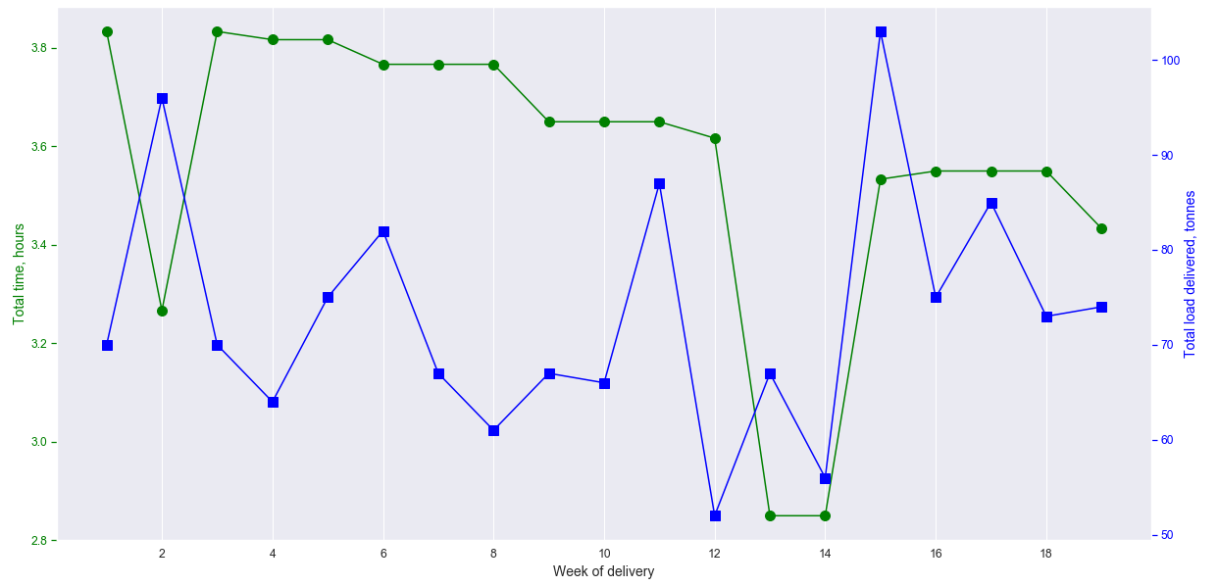
Experiment 1
Changes: increasing car_capacity of all 6 cars to 35
Assumption: since the same workload will be distributed between cars which have more than twice of initial capacity this would result in shorter routes for some cars or even unused cars.
As expected, having cars which are twice as capable as initials ones leads to a situation that cars 1 and 2 weren’t used at all because 4 other cars have managed to deal with the workload by themselves!

Slide 15
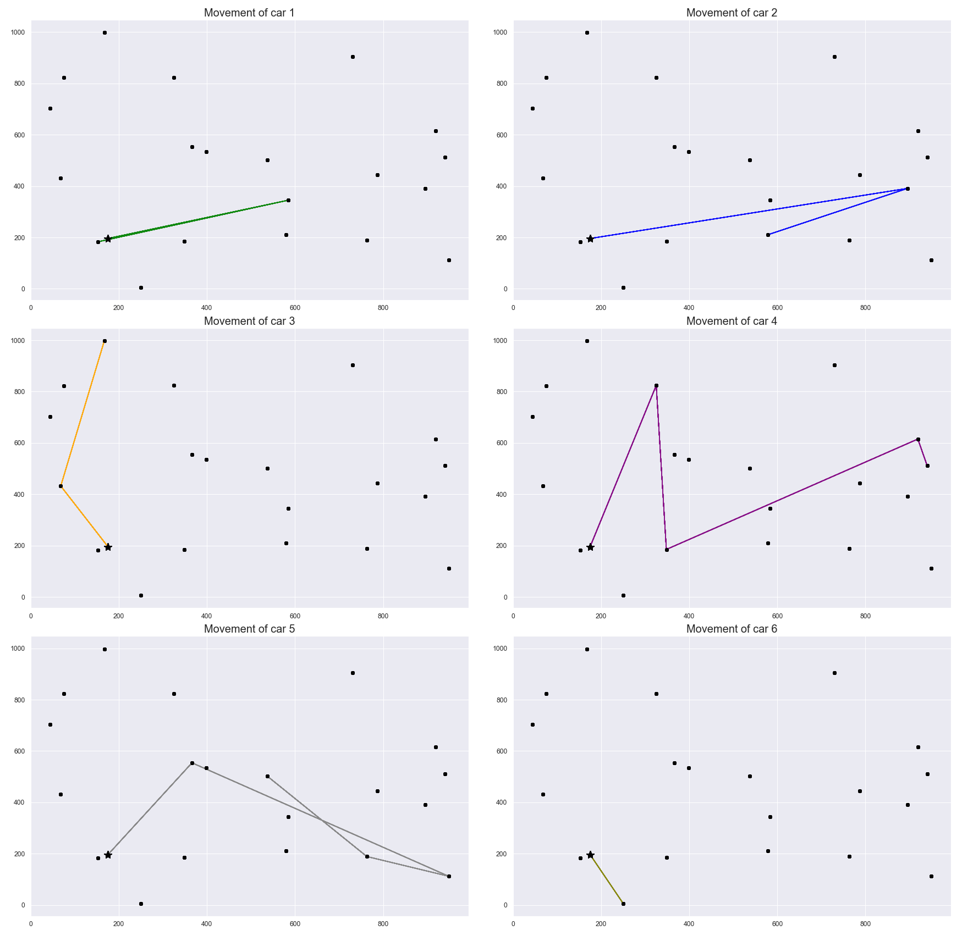
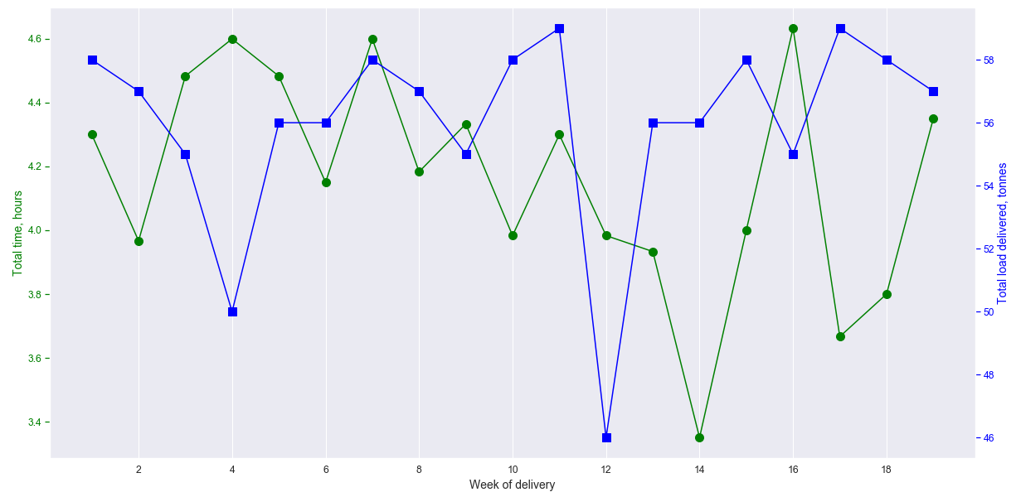
Experiment 2
Changes: decreasing car capacity to 10 for all cars, decreasing load/unload time to 2 and increasing depot capacity to 12. In such a case we have light-weight cars which need less time for load/unload + increased capacity of depo which should at least solve this issue with depo queues.
Here, looking at delivery time and load capacity chart we can see that the total number of tones delivered is significantly lower than in Experiment 1 while the time spent is a bit higher with all cars being busy all the time.

Slide 16
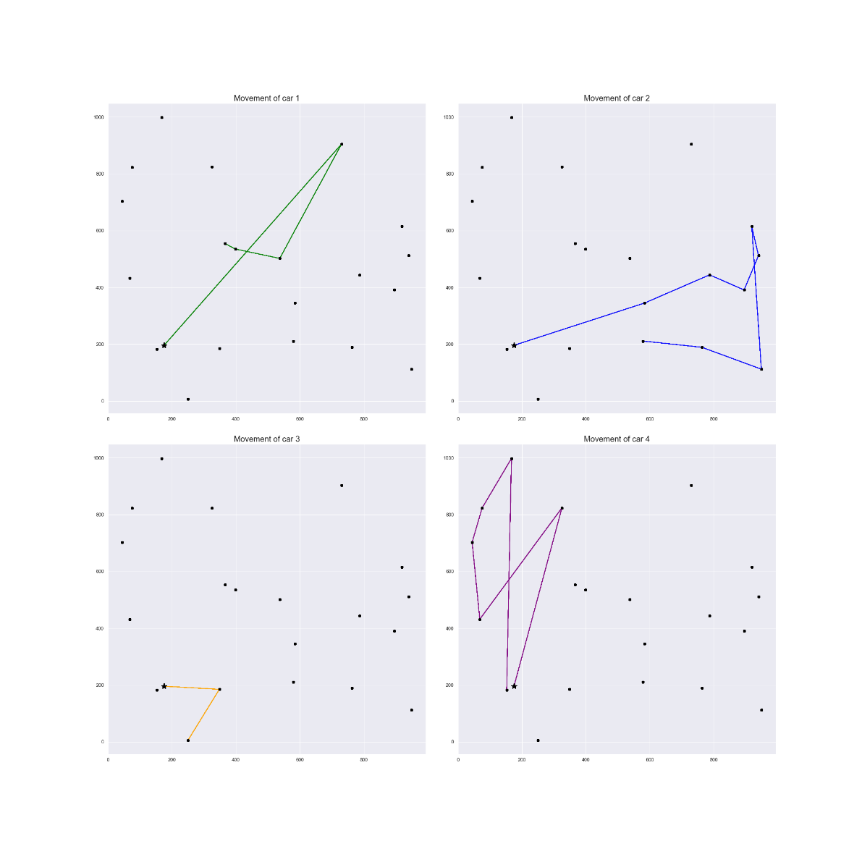
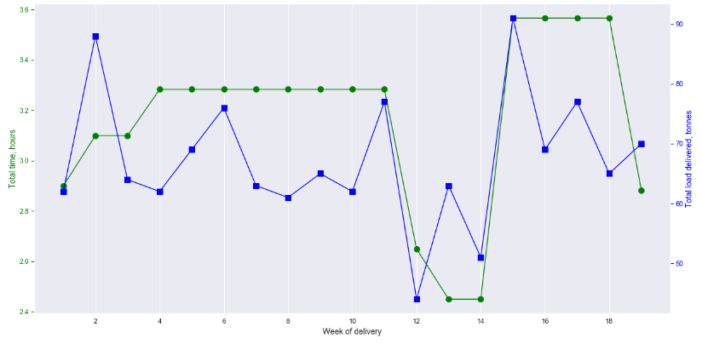
Experiment 3
Changes: as in Experiment 1 we are going to increase a capacity of all cars to 35 but now decrease the number of cars from 6 to 4. Thus, we can confirm that 2 cars are redundant in case of heavy-weight cars. Let’s see if cars will manage to deal with a workload.
Here we can see that Time and load capacity plot is almost the same as in Experiment 1 with the same fluctuation range of tons delivered but with 4 cars.

Slide 17
Conclusions
Looking at the results we can make a recommendation to any company having similar logistics problem with heavy weight transportation involved: it’s better to have few heavy-weight cars instead of many light-weight cars for a constant number of locations. The main reason: lower number of heavy-weight cars manage the same workload as higher number of lightweights. Also, from the business point of view it’s much more convenient to maintain a working condition with fewer number of cars – reduced fuel consumption and fewer number of car drivers.
On the other hand, if the company has to deliver goods to many locations in a short period of time, they can face the same issue as mentioned in the sensitivity analysis – the cars aren`t able to visit all locations and some are dropped. In this case it is reasonable to increase the number of cars as then multiple routes can be planned.

Slide 18
Further improvements
In our model we assume that all cars travel with the same speed. However, depending on the type and carry capacity, their speeds may differ. One way to deal with this is to include a coefficient decreasing the speed of trucks with higher capacity so that the model represents the reality better.
In our case we are assuming that any location may be reach from anywhere. In a city it is sometimes impossible due to the city’s topography (e.g. a bridge limits possible routes over the river). Further improvements will be required to address this.
Similarly to previous point, sometimes there are several routes that can be used to reach a certain location. So if there is a constraint on one road, another can be used. This should also be accounted for.

Slide 19
Thank you for attention!

Slide 20
References
https://www.researchgate.net/publication/313005083_Vehicle_routing_problem_Models_and_solutions
https://www.optaplanner.org/learn/useCases/vehicleRoutingProblem.html
https://www.mdpi.com/2073-8994/11/4/546/htm
https://pl.wikipedia.org/wiki/Problem_marszrutyzacji
https://developers.google.com/optimization
https://pypi.org/project/ortools/
https://github.com/google/or-tools/issues/1038
https://github.com/google/or-tools/issues/1291
https://github.com/google/or-tools/issues/78

